Slide 1

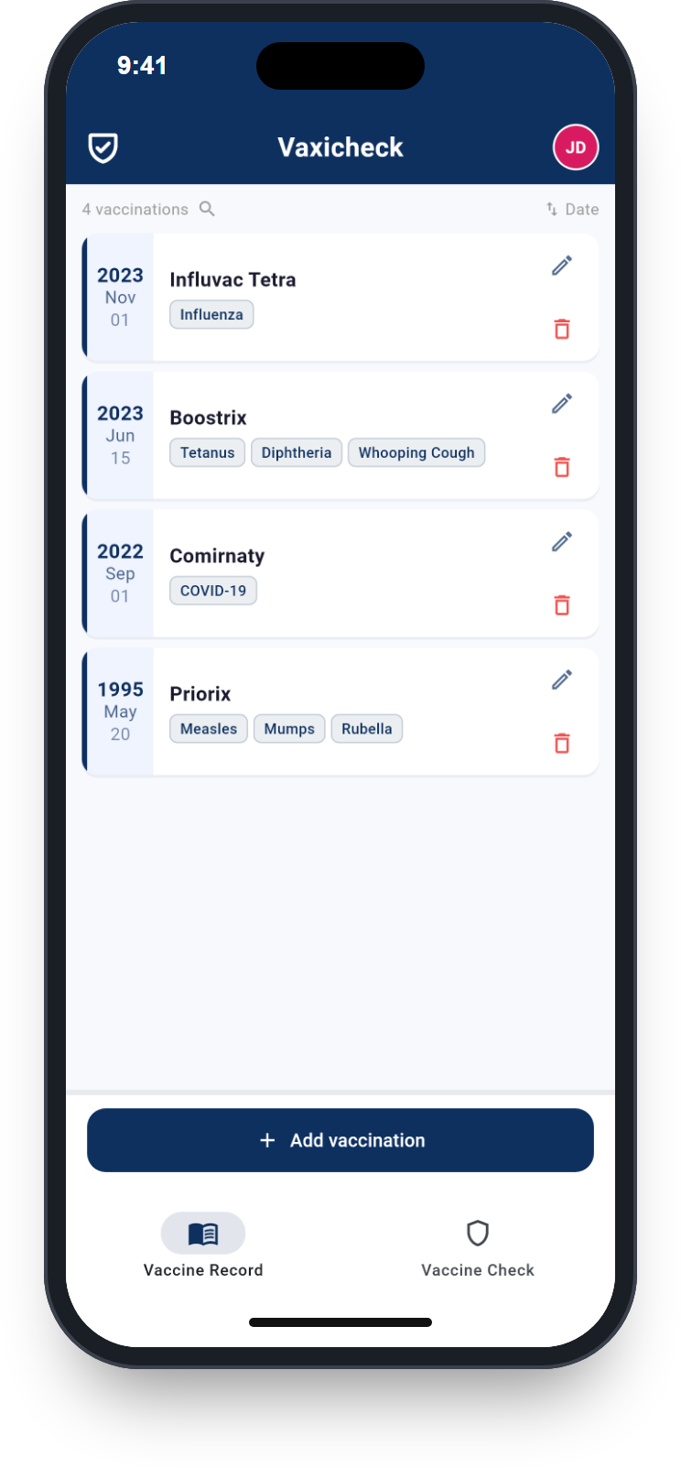

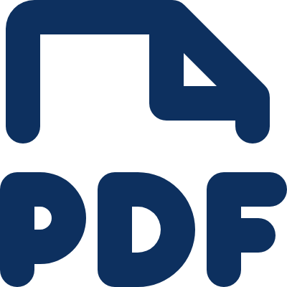


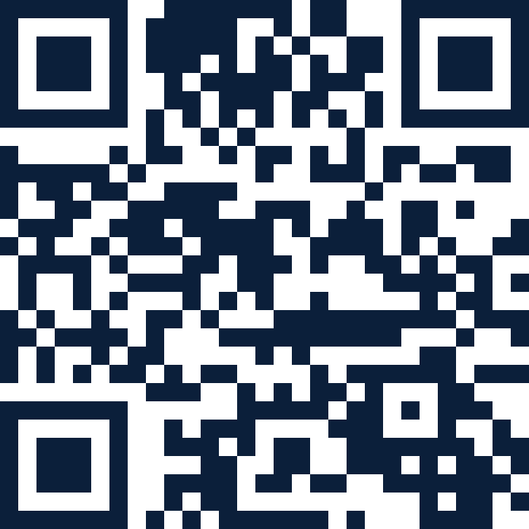


Vaxicheck
Free app for iPhone and Android
Vaccination check by photo
With the free app, vaccination entries are recognised quickly by photo and displayed in a clear structure.
Current recommendations
PDF export
Compared with current recommendations such as those of the STIKO – you see straight away which vaccinations are missing or due for a booster.
All vaccinations as a PDF, e.g. for your GP or a trip.
Data minimisation
For the whole family
Usable without entering your name, no tracking tools, GDPR-compliant, all data can be deleted at any time.
Multiple profiles, optional app lock, push reminders for vaccinations, available in 43 languages.
Download for free
www.vaxicheck.com
Developed in Cologne by MEDEPS, a spin-off of the University of Cologne.
Notes:
Vaccination check by photo
With the free app, vaccination entries are recognised quickly by photo and displayed in a clear structure.
• Current recommendations: Compared with current recommendations such as those of the STIKO – you see straight away which vaccinations are missing or due for a booster.
• PDF export: All vaccinations as a PDF, e.g. for your GP or a trip.
• Data minimisation: Usable without entering your name, no tracking tools, GDPR-compliant, all data can be deleted at any time.
• For the whole family: Multiple profiles, optional app lock, push reminders for vaccinations, available in 43 languages.
Download for free: www.vaxicheck.com
Developed in Cologne by MEDEPS, a spin-off of the University of Cologne.

